Slide 1
Chapter 4

Slide 2
Objectives

Slide 3
Objectives (cont.)

Slide 4
Objectives (cont.)

Slide 5
The built-in value types

Slide 6
The built-in value types (cont.)

Slide 7
The built-in value types (cont.)

Slide 8
How to declare and initialize a variable in two statements

Slide 9
How to declare and initialize a variable in one statement

Slide 10
How to declare and initialize a constant

Slide 11
Arithmetic operators

Slide 12
Arithmetic operators (cont.)

Slide 13
Arithmetic expressions that use integers

Slide 14
Arithmetic expressions that use decimals

Slide 15
Assignment operators

Slide 16
The syntax for a simple assignment statement

Slide 17
Statements that use the same variable on both sides of the equals sign

Slide 18
The order of precedence for arithmetic operations

Slide 19
A calculation that uses the default order of precedence

Slide 20
How implicit casting works

Slide 21
How to code an explicit cast

Slide 22
Five static methods of the Math class

Slide 23
Statements that use static methods of the Math class

Slide 24
Results from static methods of the Math class

Slide 25
How to declare and initialize a string

Slide 26
How to append one string to another string

Slide 27
Common escape sequences

Slide 28
Examples that use escape sequences

Slide 29
Examples that use verbatim string literals

Slide 30
Common .NET structures that define value types

Slide 31
Common .NET classes that define reference types

Slide 32
Common methods for data conversion

Slide 33
Some of the static methods of the Convert class

Slide 34
Statements that use ToString, Parse, and TryParse

Slide 35
Conversion statements that use the Convert class

Slide 36
Standard numeric formatting codes

Slide 37
How to use the ToString method to format a number

Slide 38
How to use the Format method of the String class to format a number

Slide 39
Code that declares and uses variables with class scope

Slide 40
How to work with scope

Slide 41
Some of the constants in the FormBorderStyle enumeration

Slide 42
The syntax for declaring an enumeration

Slide 43
An enumeration that sets the constant values to 0, 1, and 2

Slide 44
Statements that use these enumerations

Slide 45
How to declare a value type that can contain null values

Slide 46
Two properties for working with nullable types

Slide 47
How to check if a nullable type contains a value

Slide 48
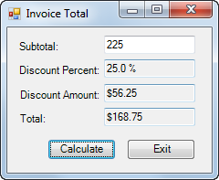
The Invoice Total form

Slide 49
The controls that are referred to in the code

Slide 50
The event handlers for the Invoice Total form

Slide 51
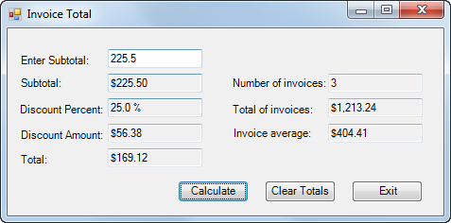
The enhanced Invoice Total form

Slide 52
The code for the class variables and two event handlers

Slide 53
The class variables and event handlers (cont.)

Slide 54
Extra 4-1 Calculate area and perimeter

Slide 55
Extra 4-2 Accumulate test score data

